Slide 1
R8: Mixed Integer Programming with p >> n
Authors: Hubert Ruczyński, Kinga Ułasik
26th June 2023

Slide 2
01
Introduction

Slide 3
Project description
Bertsimas, D., King, A., and Mazumder, R. (2015). Best subset selection via a modern optimization lens
Seven reformulations solving the main problem
Experiments on three different artificially generated datasets
Warmstarts and data driven method for upper bound choosing

Slide 4
02
Theoretical introduction

Slide 5
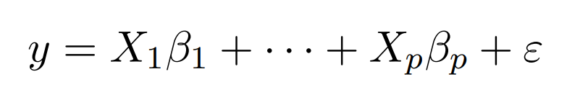
Linear regression, MIO and M(I)QP

Slide 6
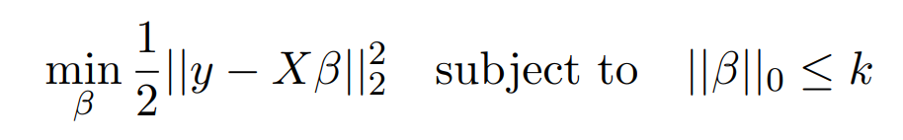
Best subset selection problem

Slide 7
03
MIO formulations for BSS problem

Slide 8
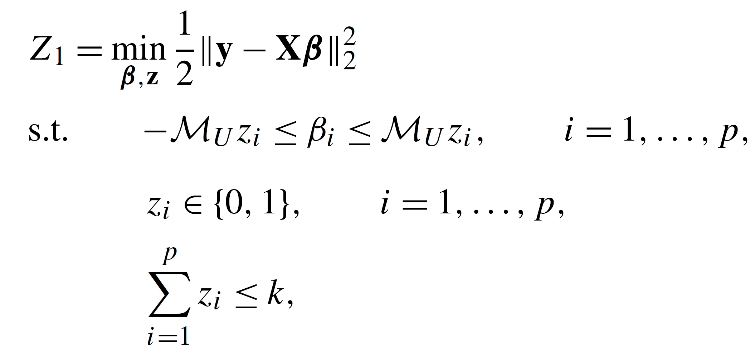
Formulation Z1

Slide 9
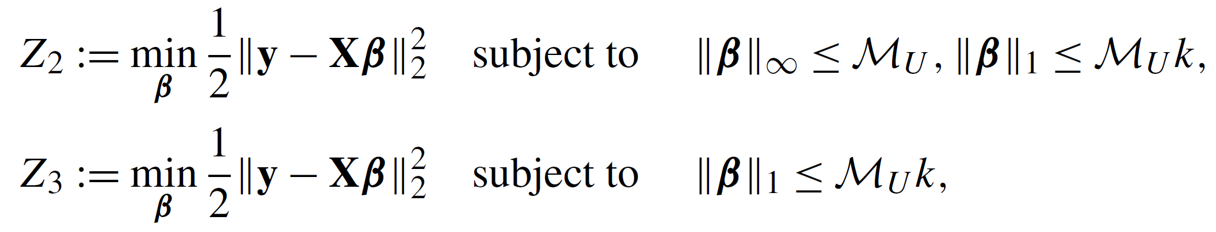
Formulations Z2 and Z3

Slide 10
04
MIO formulations using SOS

Slide 11
Specially Ordered Sets (SOS)

Slide 12
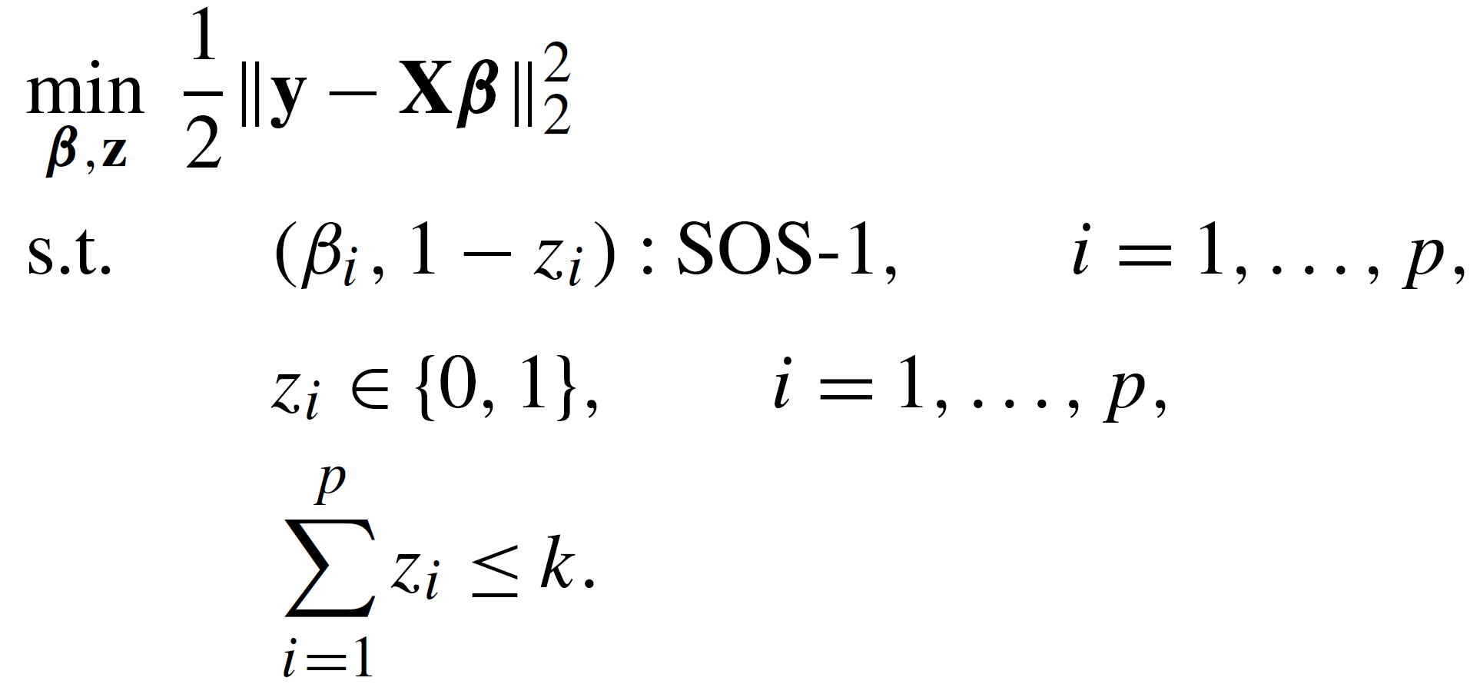
Formulation SOS1

Slide 13
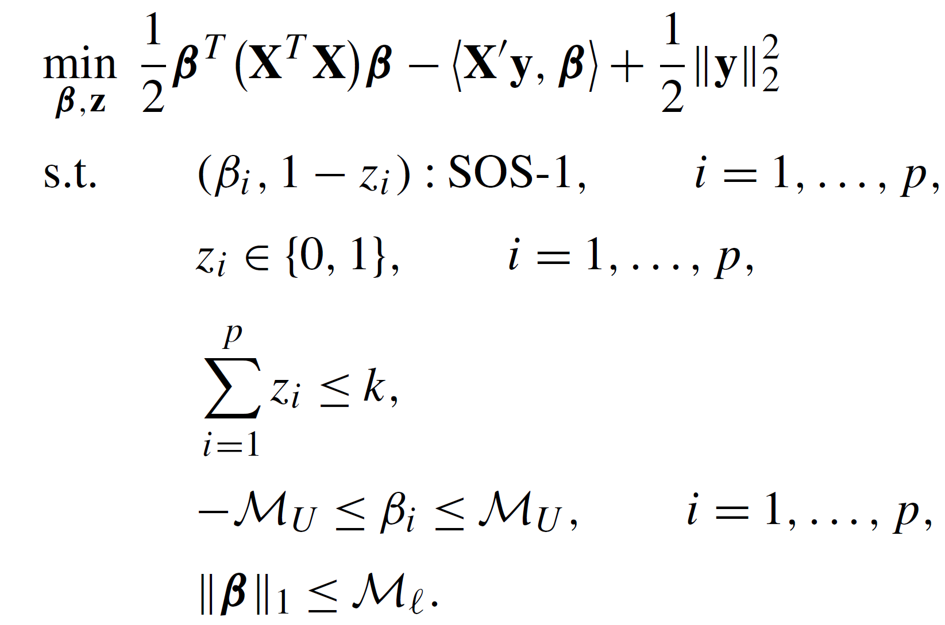
Formulation SOS2

Slide 14
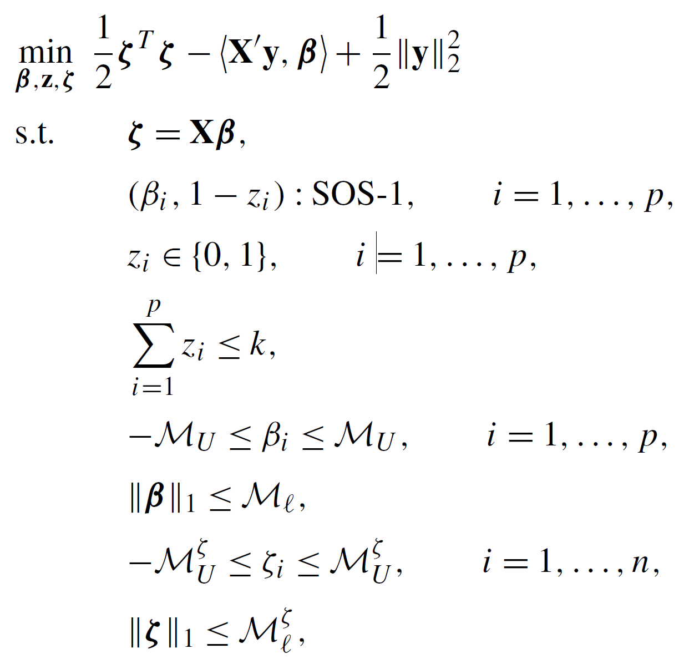
Formulation SOS3

Slide 15
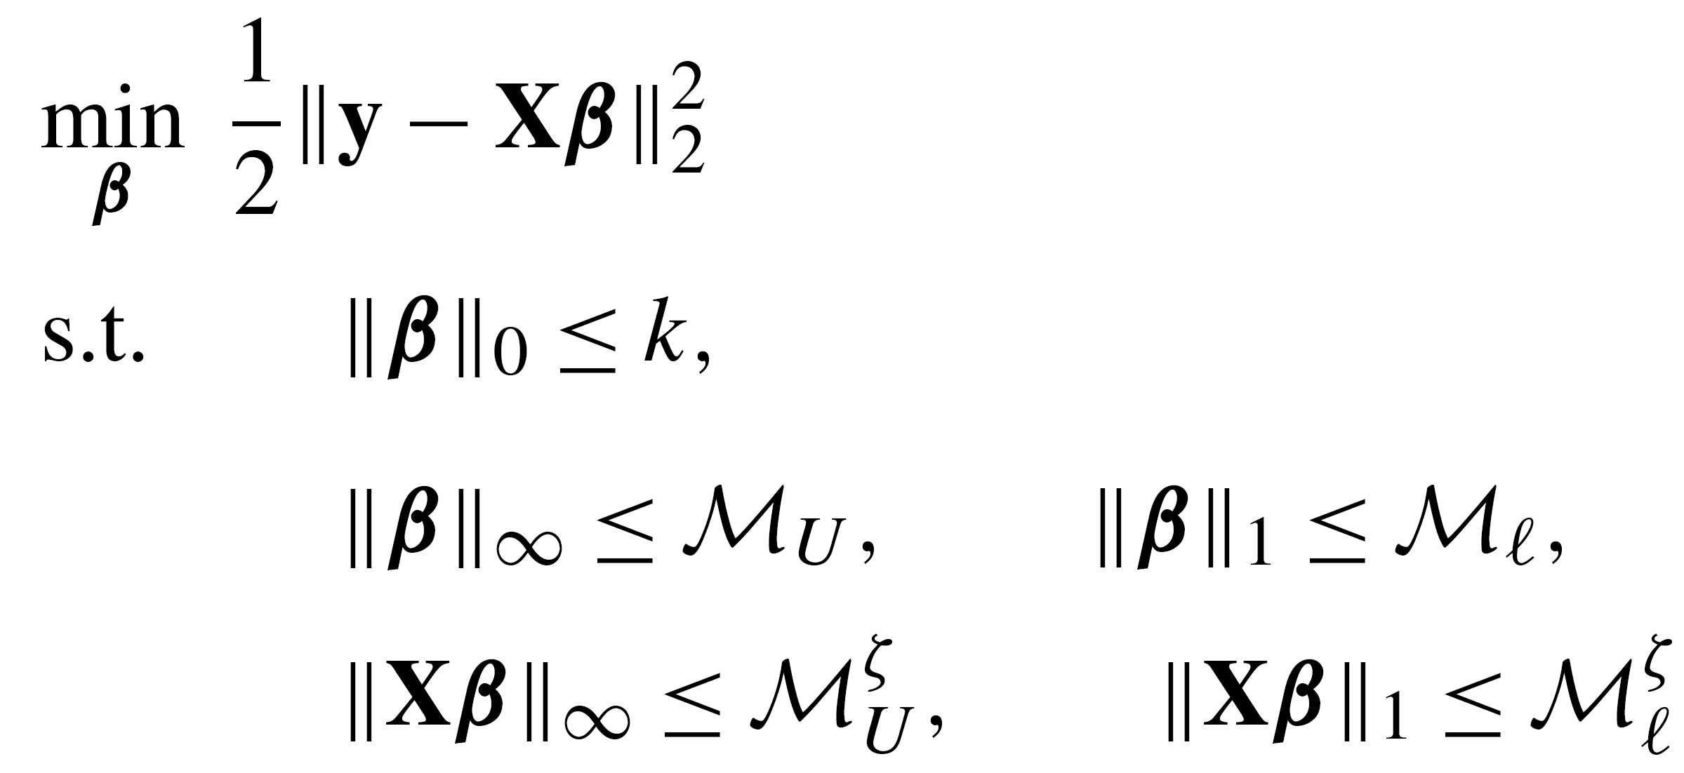
Final Formulation

Slide 16
05
Algorithm enhancements

Slide 17
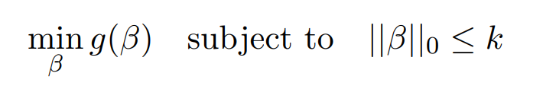
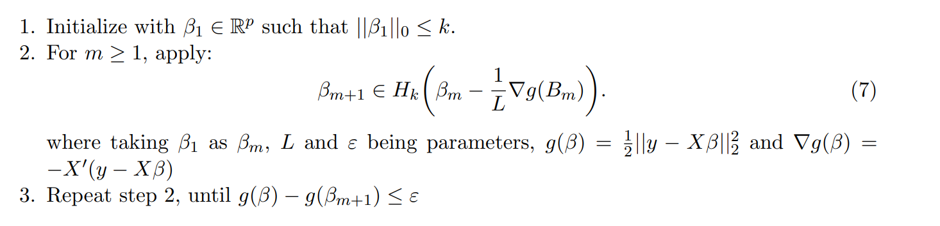

Warmstarts
General problem:
Algorithm:

Slide 18
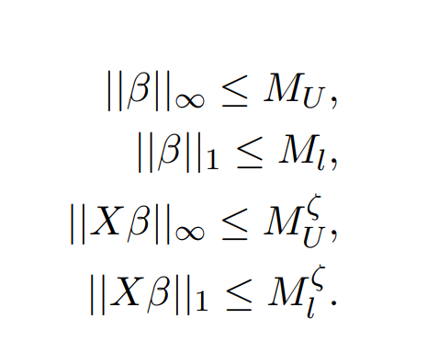
Upper Bound specification

Slide 19


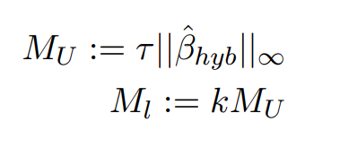
Data driven method
Let be approximation of the coefficients aquired from the warmstart algorithm. Then:

Slide 20
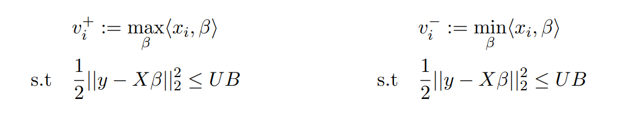
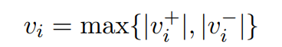
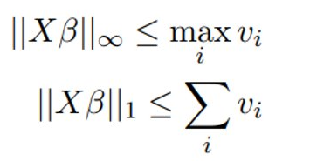


Data driven method
Let UB be the difference between real y values and the prediction of y achieved by using formula 2.4
Then we define

Slide 21
06
Implementation

Slide 22



Used Tools
Project implementation in Python,
Previous knowledge of Cplex resulted in using the official IBM Python API for this solver: a docplex package

Slide 23
07
Experiments

Slide 24
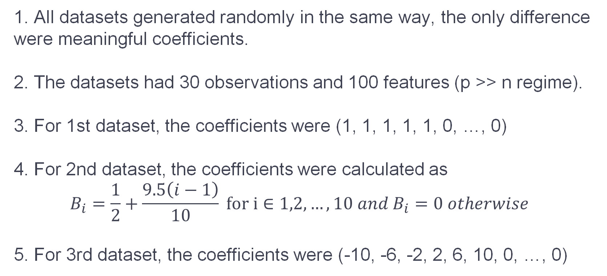
Datasets
1. All datasets generated randomly in the same way, the only difference were meaningful coefficients.
2. The datasets had 30 observations and 100 features (p >> n regime).
3. For 1st dataset, the coefficients were (1, 1, 1, 1, 1, 0, …, 0)
4. For 2nd dataset, the coefficients were calculated as $$B_{i}=\frac{1}{2}+\frac{9.5\left(i−1\right)}{10} for i∈1,2,…,10 and B_{i}=0 otherwise$$
5. For 3rd dataset, the coefficients were (-10, -6, -2, 2, 6, 10, 0, …, 0)

Slide 25
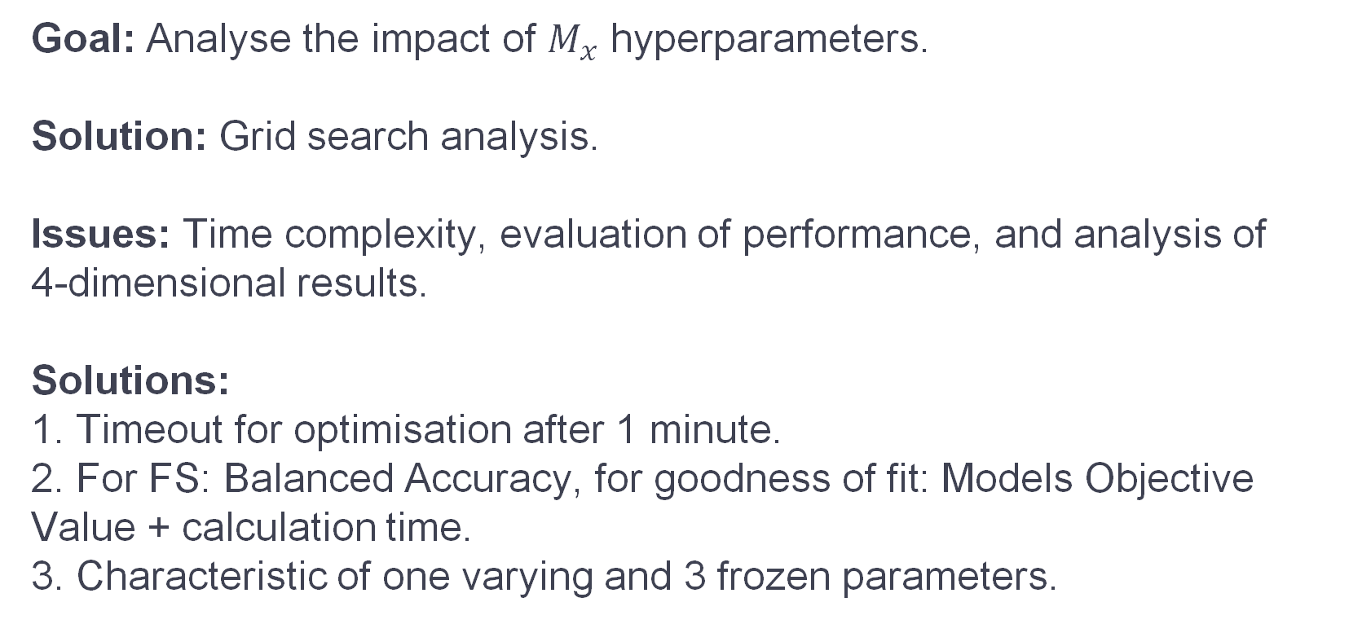
Experiments description
Goal: Analyse the impact of $M_{x}$ hyperparameters.
Solution: Grid search analysis.
Issues: Time complexity, evaluation of performance, and analysis of 4-dimensional results.
Solutions:
1. Timeout for optimisation after 1 minute.
2. For FS: Balanced Accuracy, for goodness of fit: Models Objective Value + calculation time.
3. Characteristic of one varying and 3 frozen parameters.

Slide 26
08
The outcomes
Notes:
Now, let’s get to the outcomes.

Slide 27
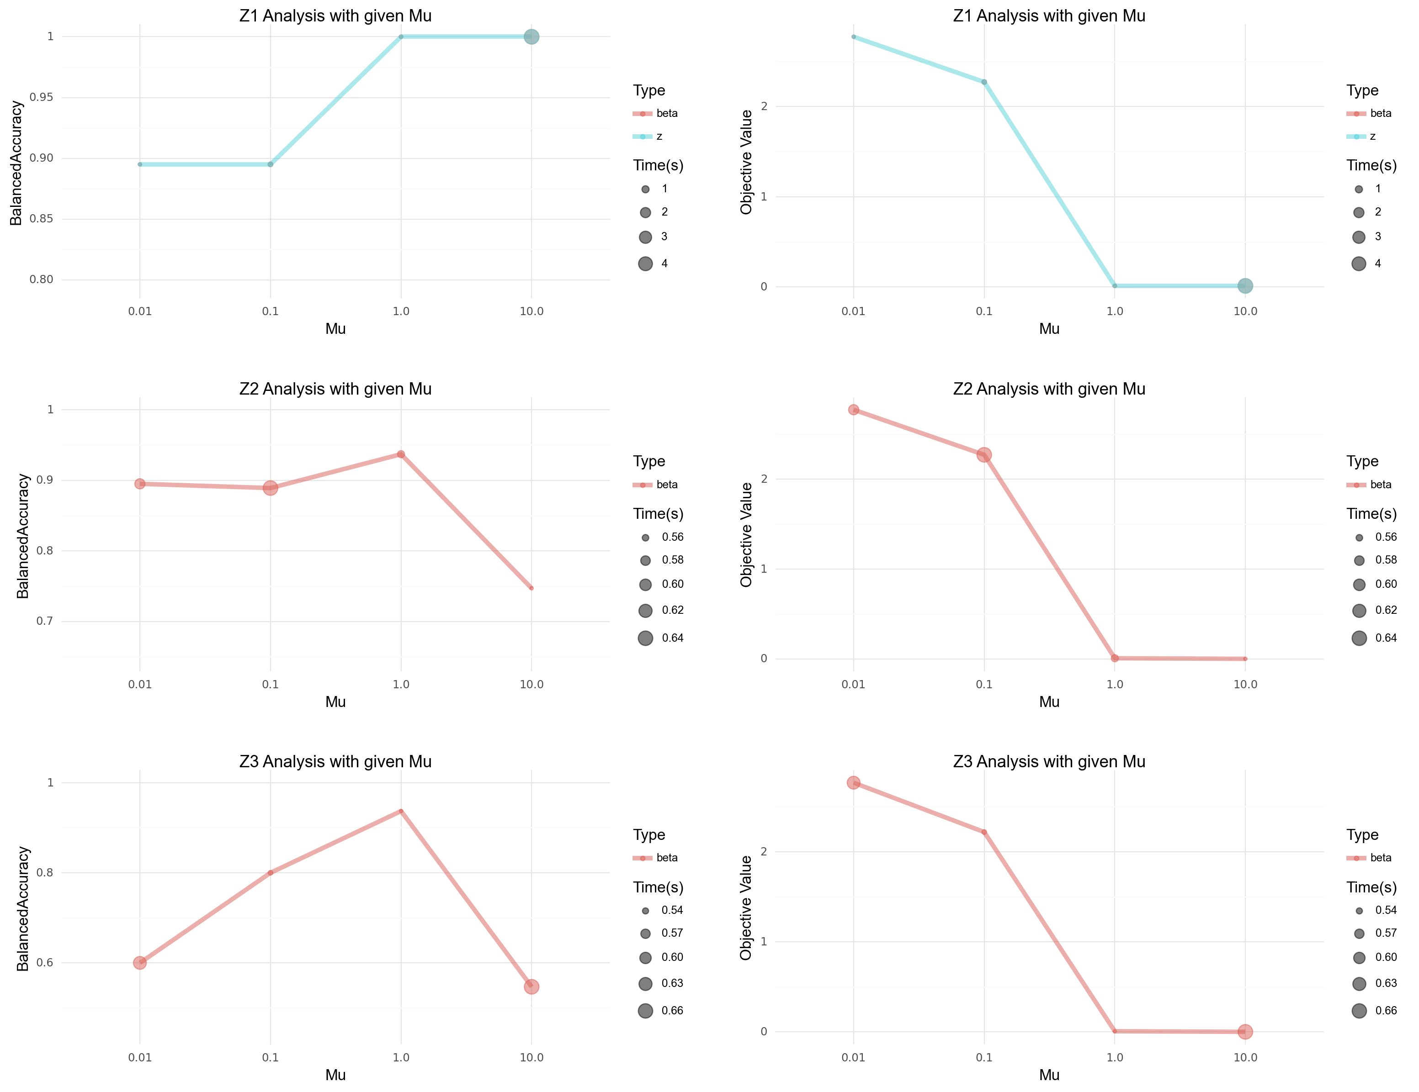
Z1, Z2, Z3 Formulations, dataset 1
Notes:
In this section we will go through the outcomes for different formulations and datasets.
Left – Balanced accuracy, Right – Objective value, Rows – different methods, for Z1 method values for betas and zs (helper) are the same, the dots size reflects time complexity
The first task was easy, methods got increadible results, with Z1 being perfect. Interestingly, for Z2 and Z3 2 params had near 0 objective value, but one had much better balanced accuracy

Slide 28
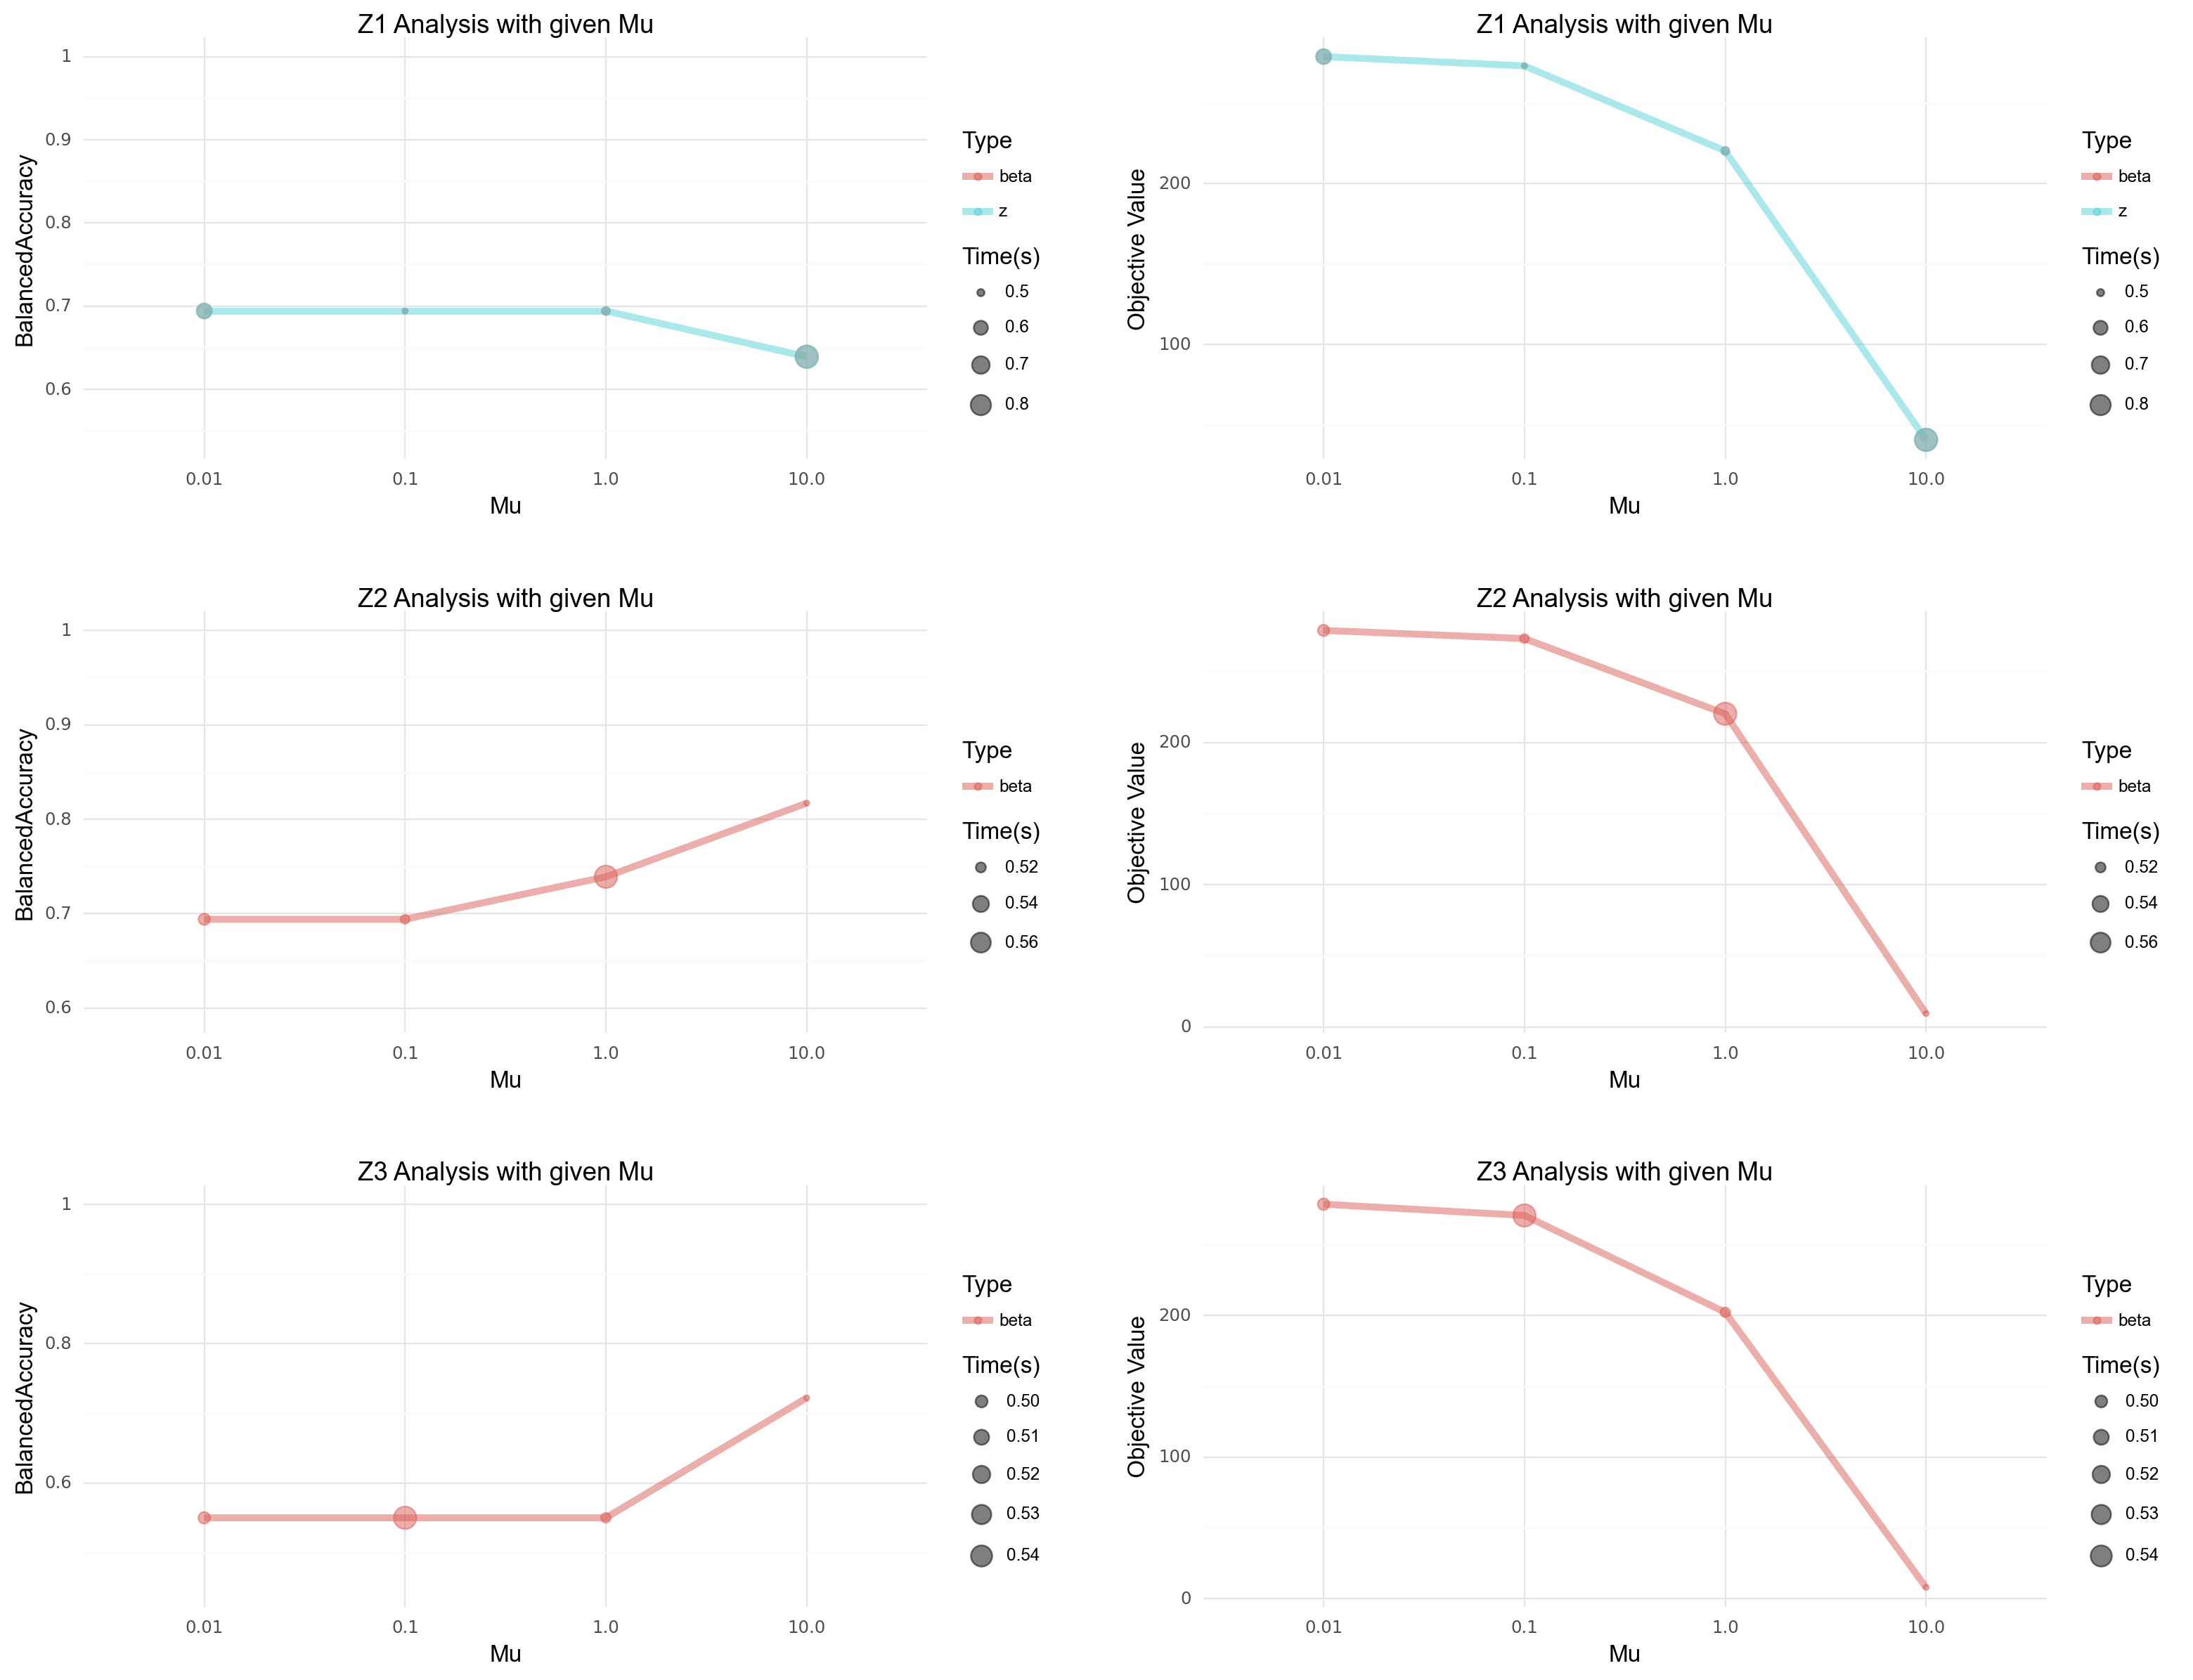
Z1, Z2, Z3 Formulations, dataset 2
Notes:
The second dataset was harder task, however for Z2 and Z3 obtained good results around 0.8, and 0.7 for balacned accuracy.
it made most errors for the smaller coefficients values
We can witness the limitations of Z1 formulation, as it has worse performance and takes longer times

Slide 29
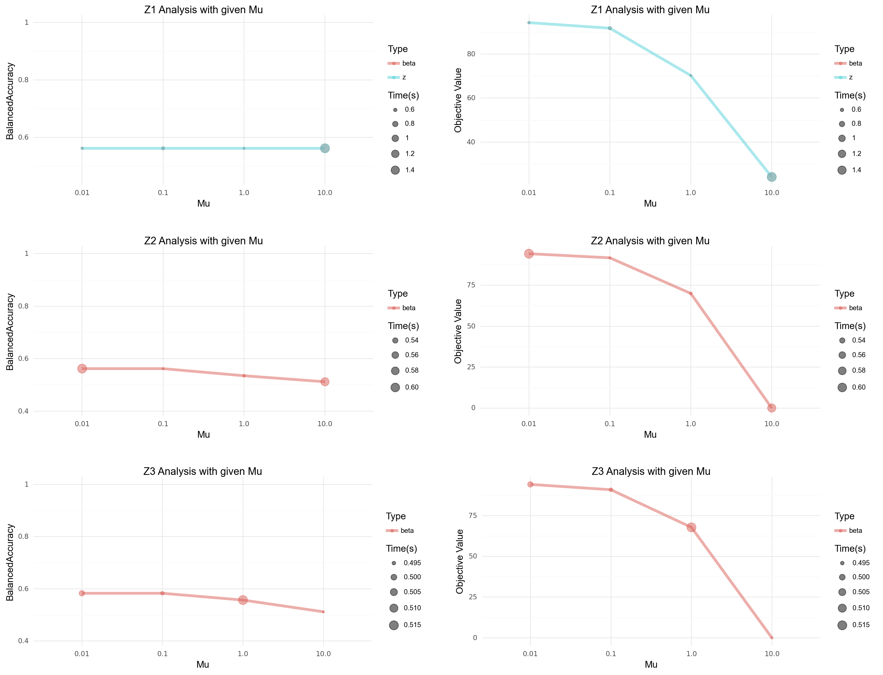
Z1, Z2, Z3 Formulations, dataset 3
Notes:
The last task was the hardest one, were BA was near 0.6, and all methods could predict only one coefficient properly. Interestingly the objective value was still able to get increadible results.

Slide 30
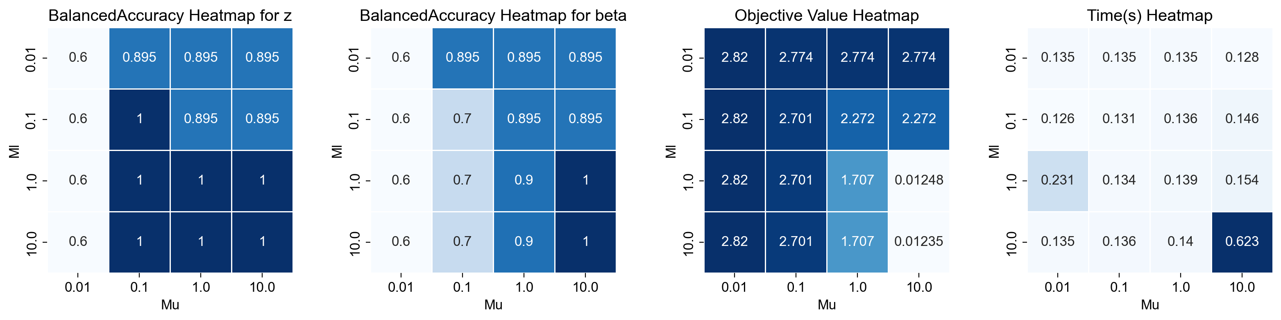
SOS2 Formulation, dataset 1
Notes:
The scond part of experiments for SOS2
In this case we have 4 heatmaps: the first one is BA for z, second BA for betas, third Objective values, and last is the time complexity
As we can see, too low Mu ruins the balanced accuracy scores.
Additionally z helper values obtained better BA than betas, it’s a shame that the algorithm didn’t ‚listen to z’s’ more.
The bigger the params were the better the results, the study would benefit from expanding the grid.
Big params = longer time

Slide 31
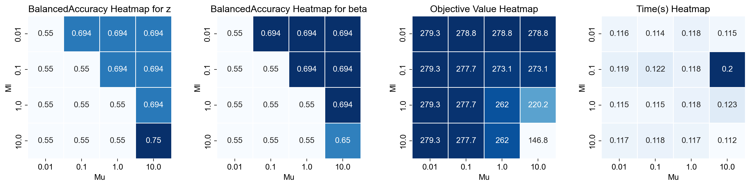
SOS2 Formulation, dataset 2
Notes:
Second task was harder again, and the model performer worse than Z2 or Z3 in terms of BA, but it was faster.
Zs were almost the same as betas,
again the bigger the params the better the results

Slide 32
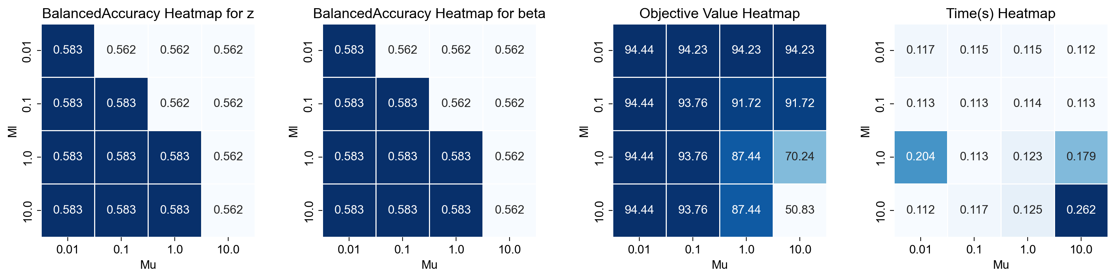
SOS2 Formulation, dataset 3
Notes:
Last task was a nightmare, results as bad as Z-methods
All observations mentioned before holds.

Slide 33
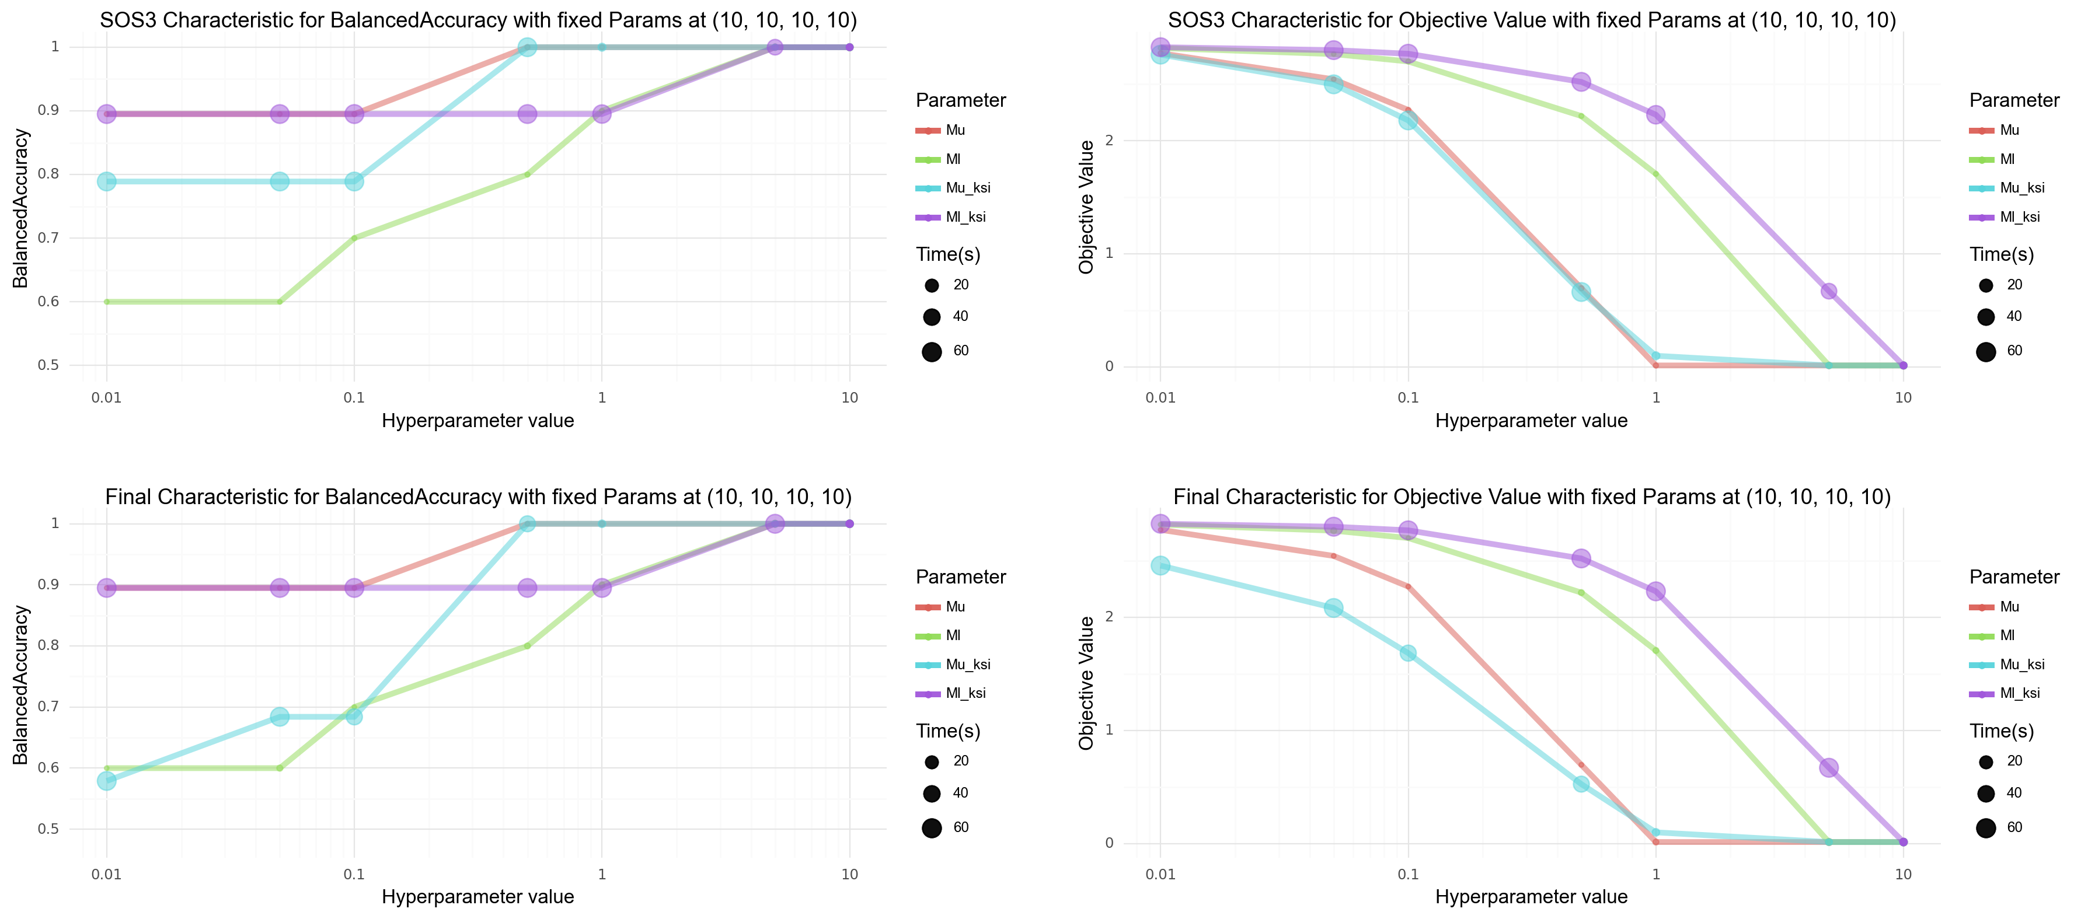
SOS3 and Final Formulations, dataset 1
Notes:
For the last two formulations, we’ve chosen the best parameters from the grid search, froze 3 of them and changed only the one, and the plots present these characteristics.
First row is for the SOS3 formulation, and second for the final.
As we can see, these two algorithms also manager to get perfect results for the first problem, and we can witness that all parameters benefit from its growth

Slide 34
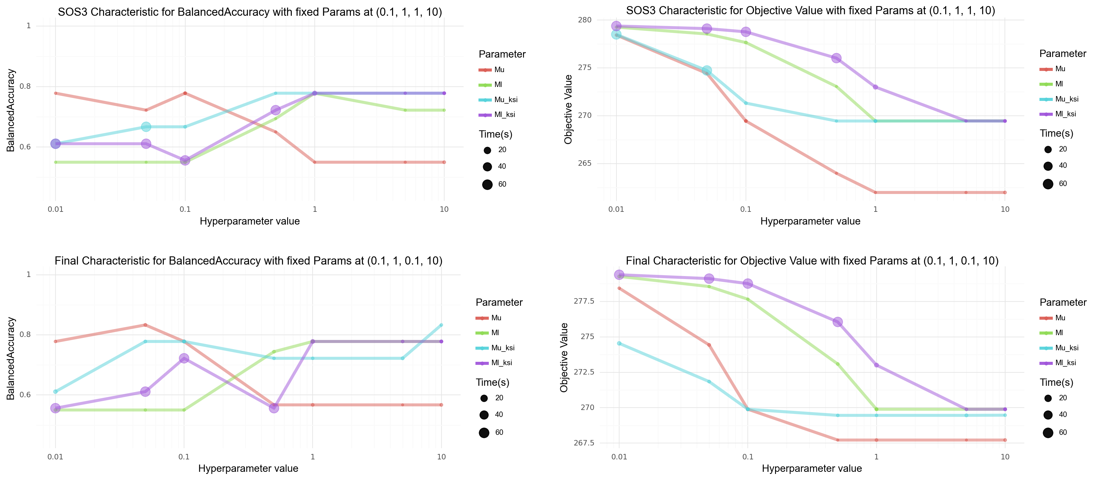
SOS3 and Final Formulations, dataset 2
Notes:
The second dataset was harder, as the best BA values were around 0.8.
We can see that in this case both method benefited from smaller values of Mu in terms of BA, even though its growth minimized the Objective value
Another interesing curve is for the Ml_ksi, as it also had small perturbation, but finally stabilized for bigger values
In general these results were comaprable to the ones of Z2 formulation, adn better than the others, although it took more time

Slide 35
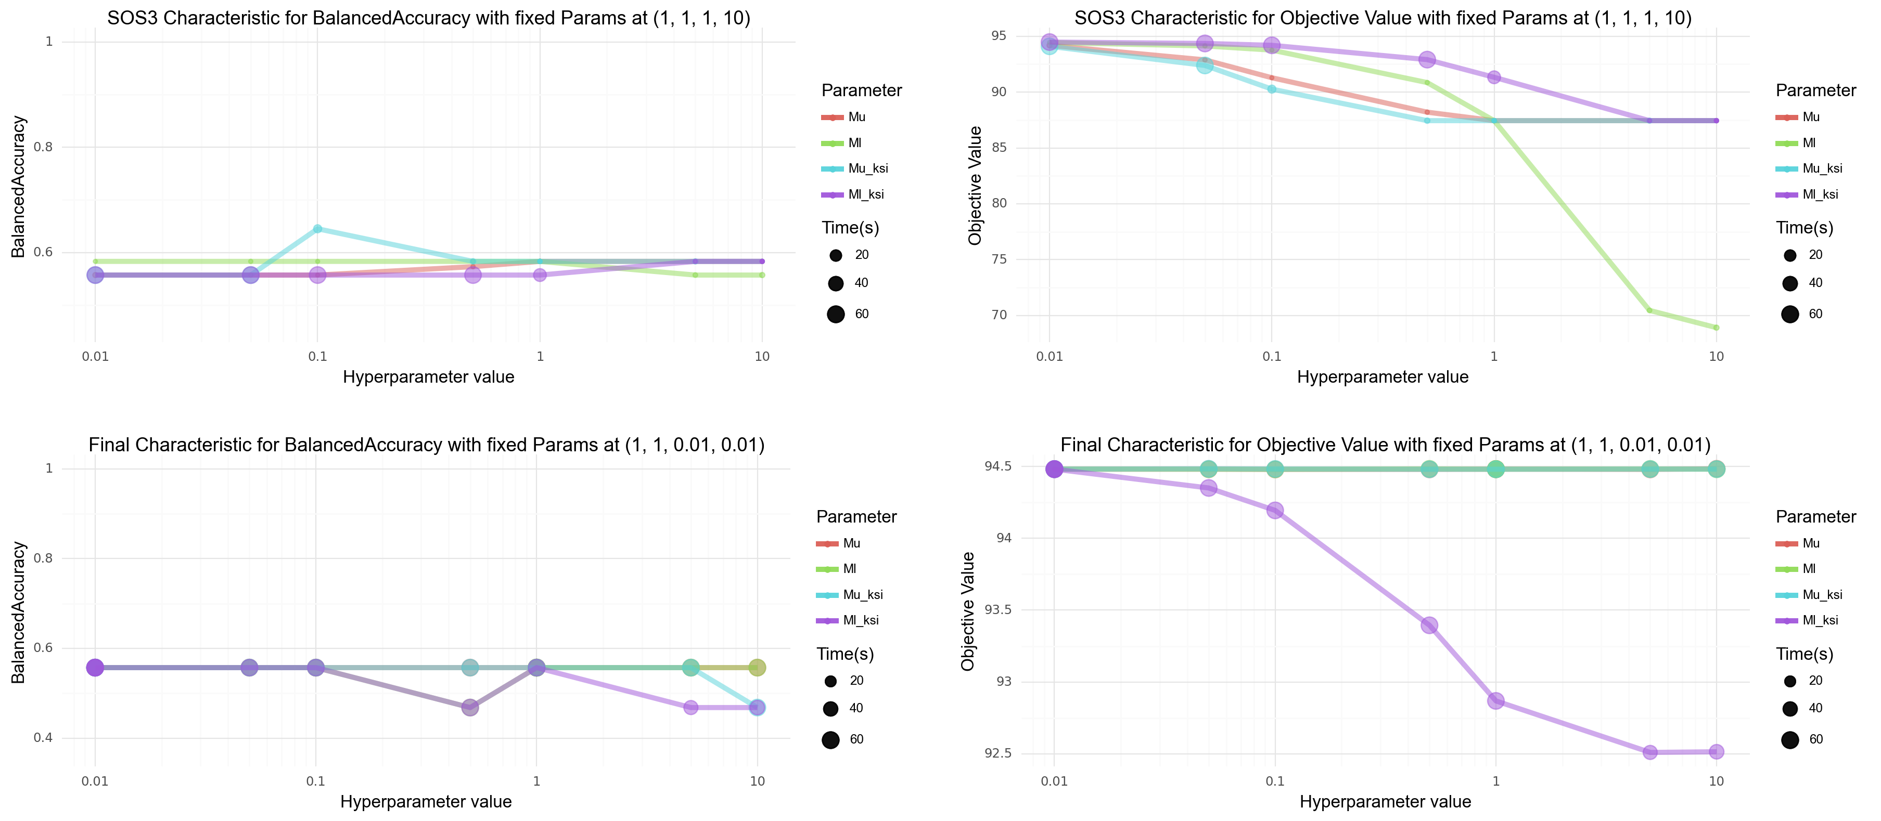
SOS3 and Final Formulations, dataset 3
Notes:
And the final dataset proved to be the hardest one again, but
The SOS3 formulation was the only one that maanged to achieve the balanced accuracy higher than 0.6.
Interestingly the final characteristics objective value benefited from higher Ml_ksi values, even though it worsened the BA performance

Slide 36
09
Encountered issues

Slide 37
Issues and Limitations of docplex
1. Lack of basic functions in the optimizer, such as the root of variable
2. No predefined advanced functions such as the p-norm, or 0-norm.
3. Official documentation without any examples of use.
4. The docplex package is rarely used, thus there are only a few helpful materials.
5. Some implementations of functions, such as absolute value, create new variables, thus it’s easy to use up the community edition limit of 1000 variables.

Slide 38
Remarks to the article
1. The authors, often didn’t provide the values / methods of estimation for crucial parameters.
2. The paper results are impossible to reproduce, due to poor description of parameters, and experiments.
3. The paper lacks any code proving that the methods work.
4. Lack of parameter specification for some artificial datasets (ex. Example 1).

Slide 39
Thanks for your attention.
Notes:
Thanks for your attention.

Slide 40
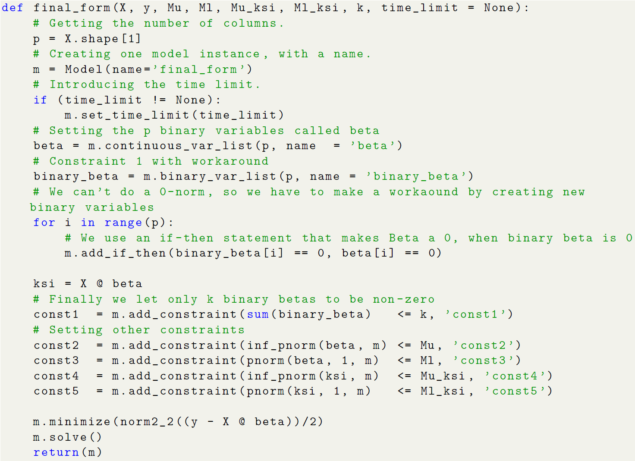
Code example: Final Formula

Slide 41
10
Further works

Slide 42
Further works
1. Expansion of tested hyperparameter values. Especially for the methods with 1 or 2 parameters.
2. Evaluation of warmstarts and upper bound methods.
3. Comparison of linear regression models on calculated coefficients.
4. Calculation of outcomes for bigger datasets (in both n, and p).
5. Evaluation on real-life datasets, like leukemia.
6. Comparison to other well established feature selection methods, such as BORUTA.

Slide 43
11
Summary

Slide 44
Summary
1. We’ve implemented seven problem formulations with docplex API from scratch.
2. We’ve implemented warmstart, and Upper Bound enhancements.
3. We’ve conducted vast hyperparameter study for each formulation, and analysed its results.
4. We’ve commented the paper and implementational issues considering docplex API.

